Slide 1
Investigating the Temporal Dynamics of EEG Signals in Sequential Sensorimotor Action
MSc Individual Project Planning

Slide 2







Multi-sensorimotor Action
Stimulus
Sensory Cortex
Motor Cortex
Actions
Determine motor action based on sensory information
How does the sensory information translate to motor action?
How long does it take to process?
Does the processing time related to the complexity of the action? And help determine which action will be done

Slide 3

Research Questions
What would affect the processing time/temporal dynamics?
Multisensory
Sequential Actions
Different Actions
Attention
Will the temporal information be useful to improve the motor imagery-based Brain Computer Interface (BCI)?
Applications
Clinical diagnosis
Functional neurological disorder (FND)
Multiple sclerosis (MS)
Motor Imagery(MI)-based BCI
Notes:
We could get the spatial information/ the function brain network from the fMRI imaging. It is, however, slow. It could not get the temporal information which is important to know the processing time.
Does multisensory affect the temporal difference?
Does sequential actions affect the temporal difference?
Does sequential different action affect the temporal difference?
Does Attention affect the temporal difference between different sensory stimuli?
Will the information from the other cortex region be useful to retrieve the constraint to focus strongly in imaging the movement?
Functional Neurological Disorder (FND) is a condition where the brain has trouble sending and receiving signals properly, even though there’s no damage to the brain or nerves that doctors can see on scans.
Multiple Sclerosis (MS) is a condition where the body’s immune system attacks the protective covering (called myelin) around the nerves in the brain and spinal cord.

Slide 4

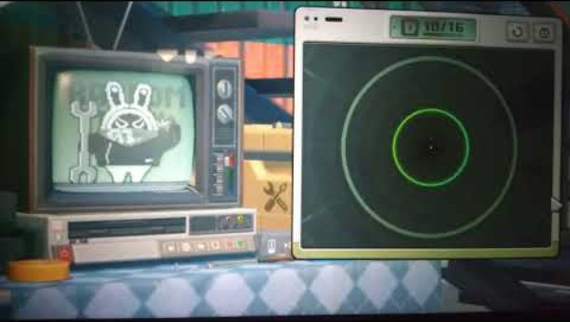
Electrode Placement
Visual Cortex (Occipital Region), Temporal Region, Sensorimotor Cortex
Evoked Signals (testing)
Steady-State VEP, Motion-Onset VEP, Auditory Brainstem Response
Event-related (De)synchronization (ERD/ERS)
Experiment (Game) (IOS/PC?) [Could be used for testing BCI]

Slide 5
How to identify the sensory-related EEG signal?
ERD/ERS, SSVEP/Motion-Onset VEP
Any existing multisensory paradigm/setup?

Slide 6
Experiment Setup Plan
App: advantage (allow haptic feedback)
Software: Could be easier
STAGE 2
BCI
Reduce delay?

